Slide 1
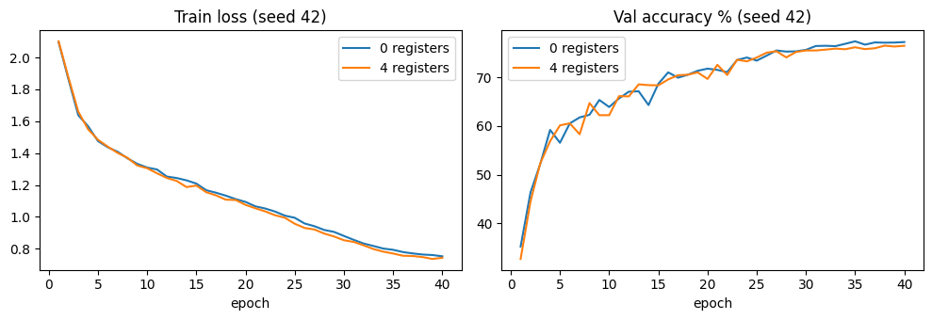
Topic : Vision Transformers Need Registers
Abhinav Saxena | Roll No: 24CS2003 | IDD CSE & AI
Problem & motivation
ViTs turn an image into patch tokens and process them with self-attention.
In large ViTs, a few patch tokens become high-norm "artifact" tokens.
They often sit on background / redundant regions and produce spiky attention maps.
Paper’s idea: add learnable register tokens as non-spatial scratch memory.
Fig: Training curves
Goal: reproduce the artifact tokens in DINOv2 ViT-g/14 and show that registers fit cleanly into a small ViT (Kaggle T4).
Notes:
This is a compute-limited reproduction of the core mechanism of 'Vision Transformers Need Registers' (Darcet et al., ICLR 2024), run on one Kaggle Tesla T4. I implemented the register-token method end to end: a token-norm analysis of the pre-trained DINOv2 ViT-g/14, and a compact ViT trained on Imagenette with 0 vs 4 registers over five seeds (42 to 46).

Slide 2
Method: Register Tokens
Standard ViT
Z₀ = [x_cls; x₁; …; x_N] + E_pos
With registers (R learnable vectors)
Z₀ʳᵉᵍ = [Z₀; r₁; …; r_R]
Transformer blocks
Z_l = TransformerBlock_l(Z_{l-1})
Prediction (registers discarded)
ŷ = W · LN(Z_L[CLS]) + b
In simple words
Registers are extra learnable vectors shared across all images.
Appended after the positional embedding, so they carry no spatial position.
They take part in self-attention at every layer (read and write).
Dropped before the classifier; no loss supervises them directly.
Our setting: R = 0 vs R = 4, only ≈768 extra parameters (4 × D=192).
Input image
Patches
Patch tokens + CLS
Append registers
Transformer blocks
Discard registers → classify CLS
→
→
→
→
→
Sequence length: 257 tokens (R=0) → 261 tokens (R=4), about 1.6% more tokens per layer.
Notes:
Registers are not output classes and are not directly supervised. They are internal scratch-space tokens: the network can read from and write to them in every layer, which gives it a place to store global information instead of recycling low-information patch tokens. After the last block they are removed and only the CLS token feeds the classifier. The cost is 4 tokens per layer and 4 x 192 = 768 parameters.

Slide 3
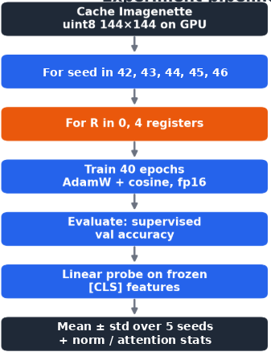
Implementation: Complete Model Code
Experiment Pipeline
class Block(nn.Module): # pre-norm transformer block
def __init__(s, dim, heads):
super().__init__()
s.n1, s.n2, s.attn = nn.LayerNorm(dim), nn.LayerNorm(dim), Attention(dim, heads)
s.mlp = nn.Sequential(nn.Linear(dim, 4*dim), nn.GELU(), nn.Linear(4*dim, dim))
def forward(s, x, return_attn=False):
h, a = s.attn(s.n1(x), return_attn) # fused SDPA, or explicit softmax
x = x + h
return x + s.mlp(s.n2(x)), a
class SmallViT(nn.Module):
def __init__(s, img, patch, dim, depth, heads, num_classes=10, num_registers=0):
super().__init__()
s.n, s.R = (img // patch) ** 2, num_registers # N patch tokens, R registers
s.patch_embed = nn.Conv2d(3, dim, patch, patch)
s.cls = nn.Parameter(torch.zeros(1, 1, dim))
s.pos = nn.Parameter(torch.zeros(1, 1 + s.n, dim)) # [CLS] + patches only
s.reg = nn.Parameter(torch.zeros(1, s.R, dim)) if s.R else None # no position
s.blocks = nn.ModuleList([Block(dim, heads) for _ in range(depth)])
s.norm, s.head = nn.LayerNorm(dim), nn.Linear(dim, num_classes)
def forward_tokens(s, x):
B = x.shape[0]
p = s.patch_embed(x).flatten(2).transpose(1, 2) # (B, N, D)
x = torch.cat([s.cls.expand(B, -1, -1), p], 1) + s.pos # (B, 1+N, D)
if s.R: # APPEND registers
x = torch.cat([x, s.reg.expand(B, -1, -1)], 1) # (B, 1+N+R, D)
for blk in s.blocks: # registers attend every layer
x, _ = blk(x)
return x
def forward(s, x):
x = s.forward_tokens(x)[:, :1 + s.n] # DISCARD registers
return s.head(s.norm(x[:, 0])) # classify from [CLS]
Flow: 1 Embed patches + [CLS] + pos → 2 Append R registers (orange) → 3 Run 6 blocks → 4 Discard registers, classify [CLS]
Notes:
Complete model, condensed from the notebook. Left: Attention (fused SDPA for training, explicit softmax in the last block when I need the attention weights) and a pre-norm Block. Right: SmallViT. Orange lines are the register mechanism. (1) self.reg is a (1,R,D) learnable parameter with no positional embedding. (2) In forward_tokens it is appended after CLS + patches + pos, so tokens go from 257 to 261. (3) All blocks process every token, so registers read from and write to image tokens in every layer. (4) features() slices x[:, :1+N] to discard registers and classifies from CLS only. Initialisation: trunc_normal std 0.02 on cls, pos, reg and Linear weights. Sanity check confirmed 257 vs 261 tokens and 2.758M vs 2.759M parameters.

Slide 4
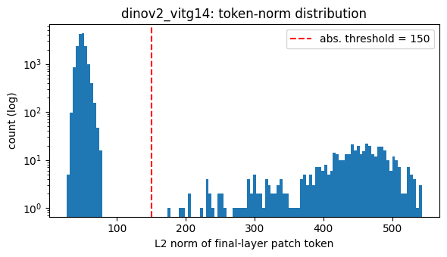
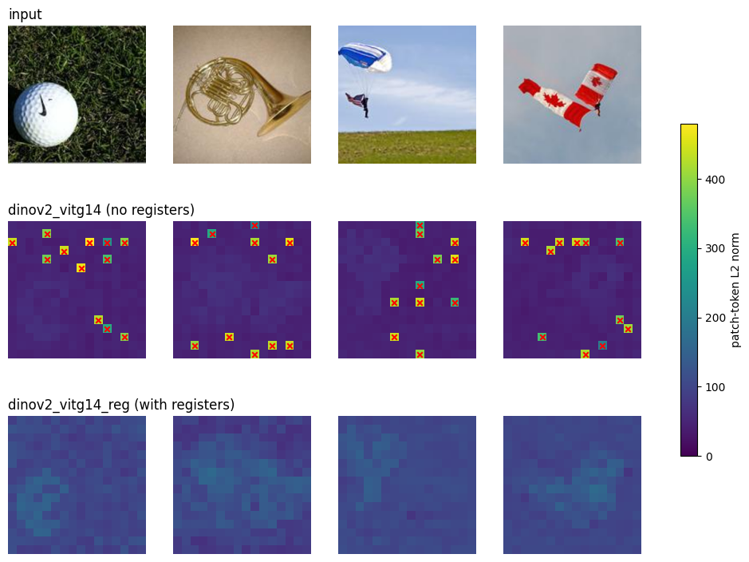
Results vs Paper
Paper expects
Our observations: DINOv2 ViT-g/14 (64 val images)
High-norm artifact tokens in large ViTs.
Registers remove them.
Biggest gains: large, self-supervised, dense tasks.
Model | Median norm | Max norm | Max / median | Outliers
No registers | 49.09 | 542.80 | 11.06 | 2.88%
Reproduced: 2.88% of tokens (≈470 of 16,384) form a separate high-norm group.
Norms reach 543 vs a median of 49 (11×); outliers sit on grass, sky, plain backgrounds.
With registers: smooth norm map, no flagged tokens (visual check).
Small ViT on Imagenette (5 seeds)
Model | Supervised val acc (%) | Linear probe (%)
0 registers | 76.50 ± 0.57 | 76.08 ± 0.41
4 registers | 77.11 ± 0.52 | 76.61 ± 0.71
Delta (4 − 0) | +0.60 | +0.54
Registers add only 768 parameters and gave higher mean accuracy, ahead in 4 of 5 seeds; a consistent trend, still within seed noise.
Notes:
Key message: I reproduced the artifact phenomenon. In DINOv2 ViT-g/14, 2.88% of final-layer patch tokens (about 470 of 16,384) form a separate high-norm group: median norm 49.1, maximum 542.8, about 11 times the median. The absolute (>150) and relative (>2.5x median) rules flag the same fraction, and the tokens sit on grass, sky and plain backgrounds, as in the paper (which reports roughly 2%). For the register variant I checked the norm maps visually: smooth, no flagged tokens; I did not compute a numeric outlier fraction. In the small ViT, registers add only 768 parameters and gave a higher mean accuracy (+0.60 supervised, +0.54 probe), ahead in four of five seeds. The gain is about one seed standard deviation (Welch p = 0.12 and 0.19), so I call it a consistent small trend that more seeds would need to confirm.

Slide 5
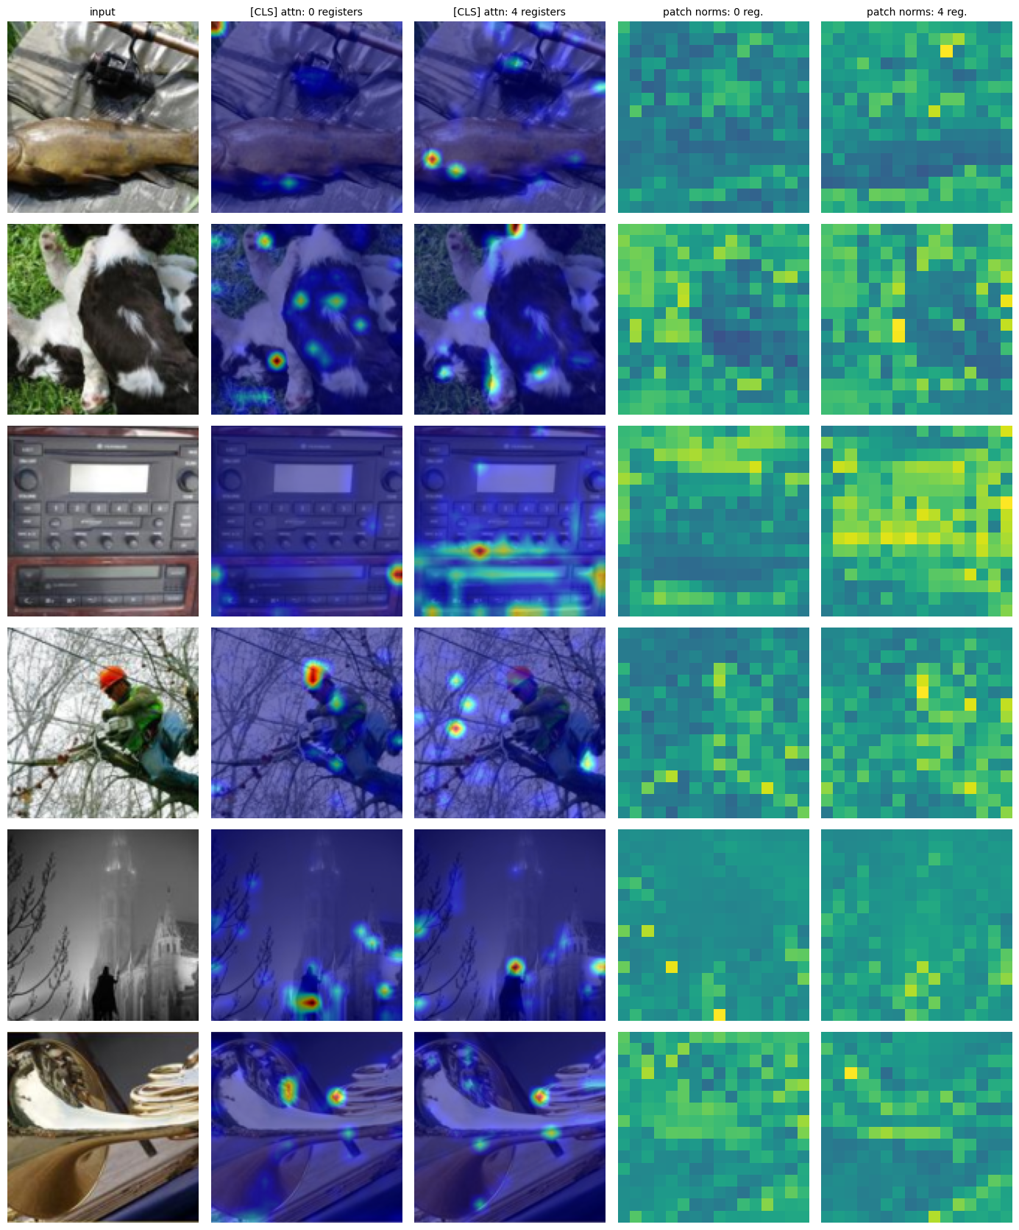
Ablation, Limits & Takeaways
Metric (seed 42, 1000 val imgs) | 0 registers | 4 registers
outlier_frac | 0.0000 | 0.0001
max / median norm | 1.759 | 1.702
CLS attention entropy | 0.744 | 0.777
CLS attention to registers | 0.0000 | 0.0065
Observations
No high-norm artifacts in the small ViT, as expected at this scale.
Registers: lower max/median (1.76 → 1.70), more spread CLS attention.
Registers get 0.65% of final-layer CLS attention.
Accuracy: +0.60 / +0.54 points at negligible cost.
Limits & next steps
Artifacts likely need larger models, longer / self-supervised training.
Next: register-count sweep, dense tasks, larger register models.
Fig: Attention and norms
We reproduced the artifact tokens in DINOv2 ViT-g/14 and built a register ViT end to end: 768 extra parameters, higher mean accuracy in 4 of 5 seeds. Showing artifact removal itself needs larger models and longer training.
Notes:
The small ViT (2.76M parameters, 40 epochs, under 10,000 images) does not develop artifacts, which is expected at this scale and is a property of the setup, not of the implementation. What the experiments do show: the mechanism is easy to add, costs 768 parameters and about 2% extra training time, and gives slightly lower max/median norm (1.759 to 1.702) and more spread CLS attention (entropy 0.744 to 0.777). The registers receive 0.65% of last-layer CLS attention. These attention statistics are from seed 42 only. Natural next steps: a sweep over the number of registers, dense-task evaluation, and larger or self-supervised register models.

